Slide 1
Chapter three
Topics in Differentiation

Slide 2
All graphics are attributed to:
Calculus,10/E by Howard Anton, Irl Bivens, and Stephen Davis
Copyright © 2009 by John Wiley & Sons, Inc. All rights reserved.

Slide 3
Topics in Differentiation
We are now going to differentiate (take the derivative of) functions that are either difficult to differentiate in y= form (defined explicitly) or impossible to write in y= form and “differentiate directly”.
Therefore, we need new methods such as implicit and logarithmic differentiation to find these derivatives in another and/or faster way.

Slide 4
Explicit vs. Implicit
For more information on the difference between explicitly and implicitly defined, please read pages 185-186.
In general, it is not necessary to solve an equation for y (in terms of x) in order to differentiate a function.
On the next slide, I will take the derivative of a relatively easy function two different ways so that you can see the difference.

Slide 5
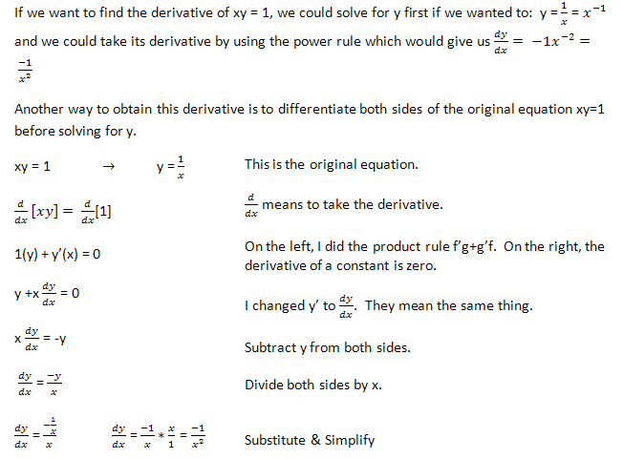
Example Two Ways

Slide 6
Example Results
We got the same answer using both methods.
Solving for y was obviously much faster, but it is not always possible to solve for y first (see example on next slide).
Now we know another method.
  Differentiate “implicitly”
  Solve for dy/dx
  Then substitution

Slide 7
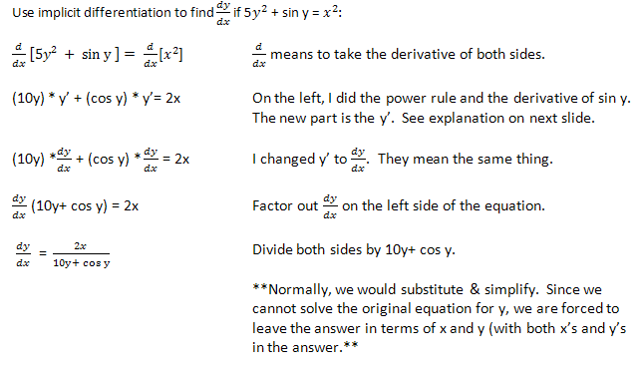
Example Where We Cannot Solve for y First

Slide 8
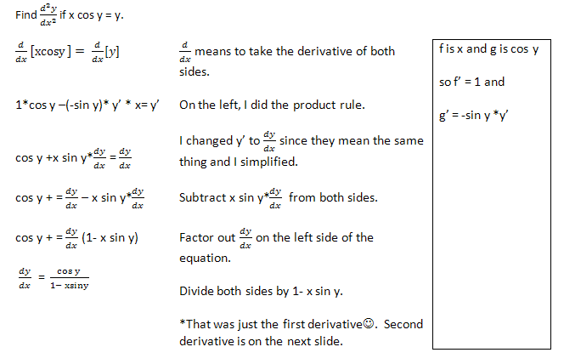
Second Derivative Example

Slide 9
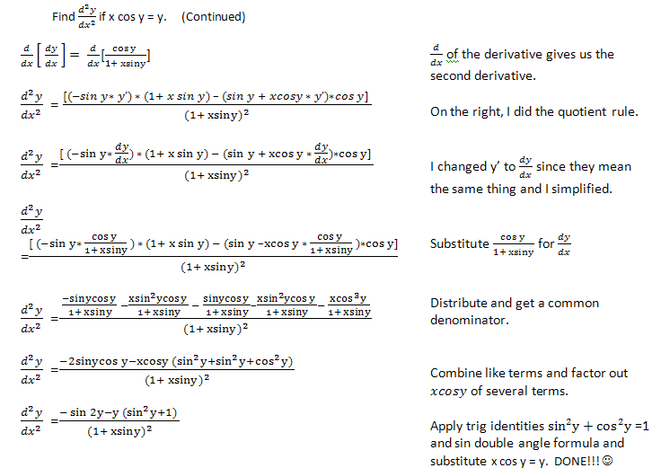
2nd Derivative Example (cont.)

Slide 10




Natural Log vs. Common Log
Natural Logarithm | Common Logarithm
The derivative when you are taking the natural log of just x. | The derivative when you are taking the logarithm with a base other than e of just x.
The derivative when you are taking the natural log of something other than x (u). You must use the Chain Rule. | The derivative when you are taking the log with a base other than e of something other than x (u). You must use the Chain Rule.

Slide 11
Why is the Natural Logarithm preferred?
Among all possible bases, base e produces the simplest formula for the derivative of log_{b}x. This is the main reason (for now ☺) that the natural logarithm function is preferred over other logarithms in Calculus.
Look at the previous slide and notice how much smaller the formulas are in the first column than those in the second column.

Slide 12
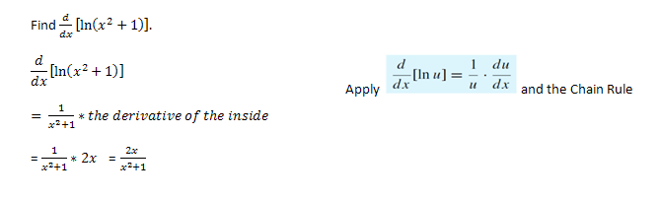
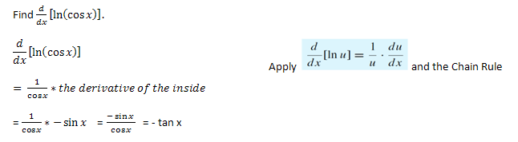
Examples

Slide 13

Logarithmic Differentiation
Some derivatives are very long and messy to calculate directly, especially when they are composed of products, quotients, and powers all in one function like
You would have to do the product and chain rules within the quotient rule and it would take quite awhile.
Therefore, we are going to first take the natural logarithm of both sides and use log properties to simplify before we even start to find the derivative.

Slide 14
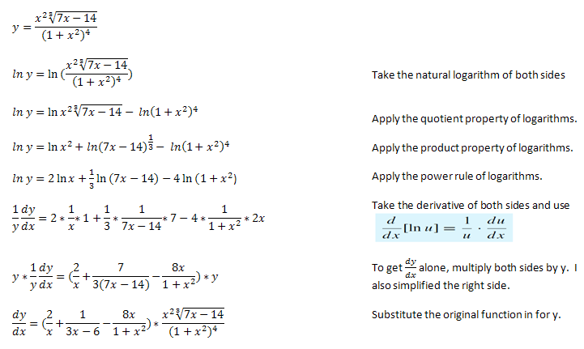
Logarithmic Differentiation Example

Slide 15
Logarithmic Differentiation Steps
Take the natural log of both sides (whatever you do to one side, you must do to the other) since base e is easier than any other base (see slide #5).
Apply ALL of the possible properties of logarithms.
Take the derivative of both sides.
Multiply both sides by y.
Substitute the original in for y and simplify.

Slide 16

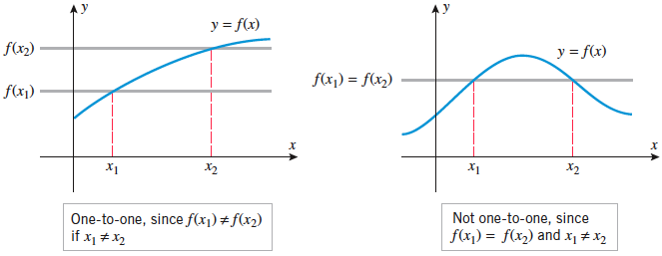

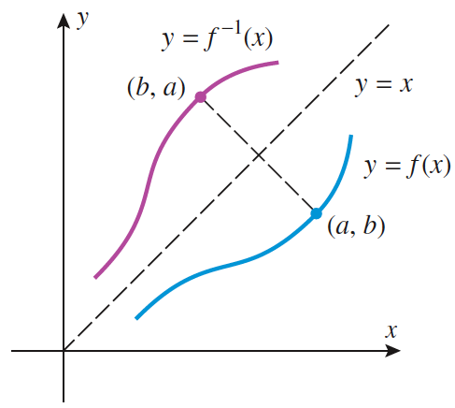
One-to-One and Inverse Functions (reminders from Section 0.4)

Slide 17
One-to-One and Inverse Functions (continued)
Note: Sometimes, it is necessary to restrict the domain of an inverse f⁻╵(x)=x or of an original f(x) in order to obtain a function (see examples on page 44).
A function f(x) has an inverse iff it is one-to-one (invertible), each x has one y and each y has one x (must pass vertical and horizontal line tests).

Slide 18
Increasing or Decreasing Functions are One-to-One
If the graph of a function is always increasing (f’(x)>0) or always decreasing (f’(x)<0), then it will pass the horizontal and vertical line tests which means that the function is one-to-one.

Slide 19




Derivative of Exponential Functions
After the last few slides, you probably do not want to see a proof here. ☺ If you would like to read the proof(s) of these derivatives, please see pages 198-199.
Base b (not e) | Base e (only)
The derivative when you have any base other than e to just the x power. | The derivative when you have only base e to just the x power.
The derivative when you have any base other than e to something other than just the x power (u). | The derivative when you have only base e to to something other than just the x power (u).

Slide 20
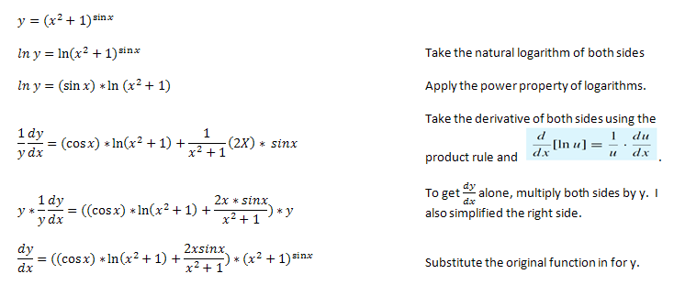
Logarithmic Differentiation Example

Slide 21
Related Rates Problems
In related rates problems, we are trying to find out the rate at which some quantity is changing related to other quantities whose rates of change are known.

Slide 22

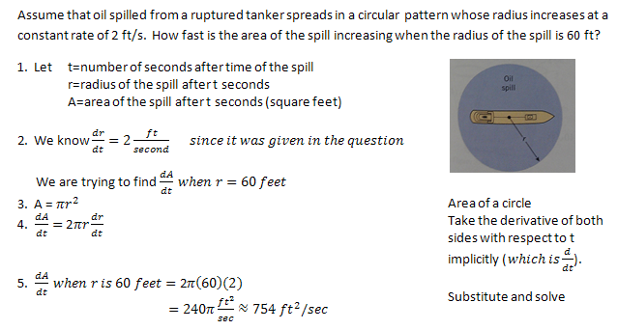
Oil Spill Example:

Slide 23
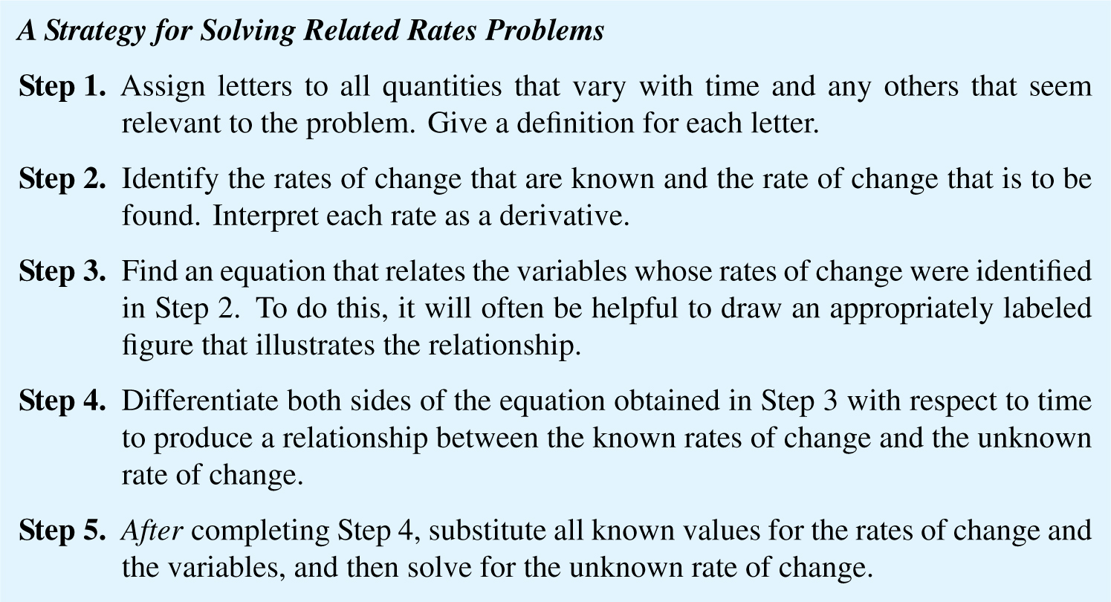
Strategy for Solving Related Rates Problems
If you noticed the numbers #1-5 on the last example, those are the steps that I suggest you follow when solving these problems.
  Draw and label
  Have and need
  Relating equation
  d/dt both sides
  Substitute/solve

Slide 24
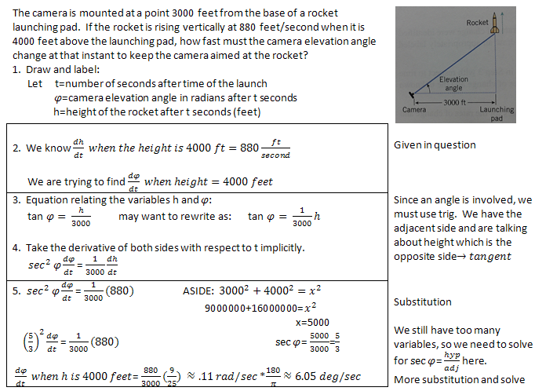
Rocket Example

Slide 25
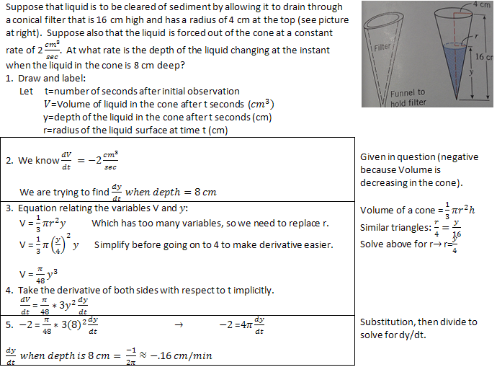
Similar Triangles Example

Slide 26
Indeterminate Forms
In this section, we will discuss a general method for using derivatives to find limits.
This method will allow us to find limits that we were previously only able to find by graphing (like the squeezing theorem).
Many computers use this method (internally) when calculating limits.

Slide 27
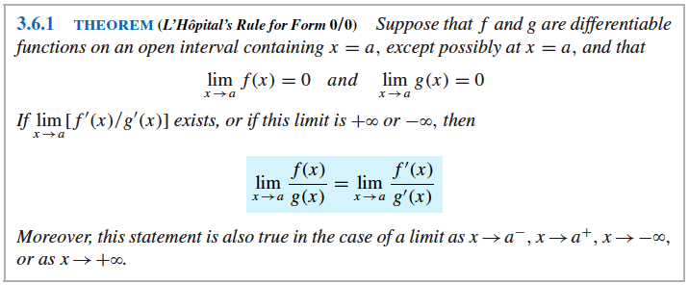
0/0 Type Indeterminate Form: L’Hopital’s Rule

Slide 28
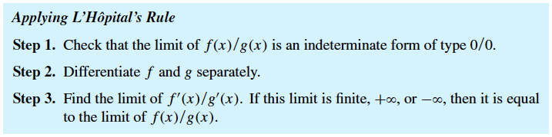
Warning and Steps
** Please notice that the numerator and denominator are differentiated individually. (you take their derivatives separately) It is NOT the same as (f/g)’, so you are NOT using the quotient rule.**

Slide 29
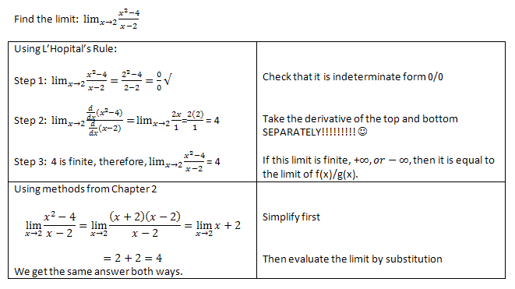
Example Two Ways

Slide 30
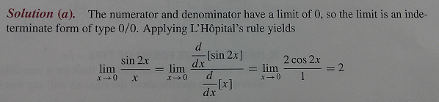
Another example
There are five more similar examples on pages 221-222 if you are interested.
For the example below, I cannot use algebraic methods from Chapter 2 and I do not know how to graph it without a calculator.
This is when L’Hopital’s Rule is especially useful.

Slide 31
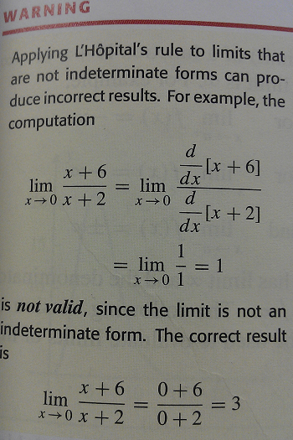
Make sure you do step 1!

Slide 32
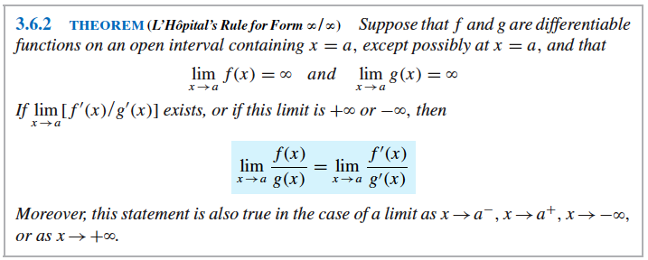
Another version of L’Hopital’s Rule
This version is used to find the limit of ratios in which the numerator and denominator both have infinite limits.

Slide 33

Example this version of L’Hopital’s Rule
Similar steps are required as the original version of L’Hopital’s Rule.
  Verify that numerator and denominator have infinite limits.
  Derivative of numerator and denominator SEPARATELY.
  Find the new limit.

Slide 34
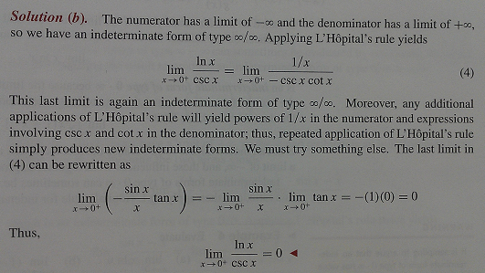
Repeated applications of L’Hopital’s Rule Example
Sometimes you will get an indeterminate form again after applying L’Hopital’s Rule the first time and it will be necessary to do it again.

Slide 35
Other indeterminate forms
There are several other types of indeterminate forms that you will see on pages 224 & 225.
Many of you keep forgetting about the other types, so I suggest you look at these two pages and see if you have questions.

Slide 36
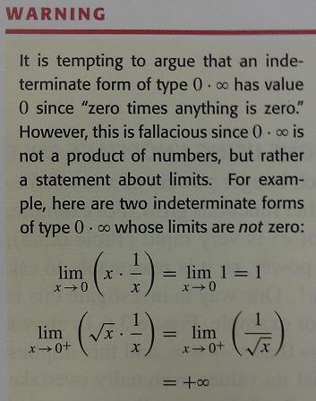
One Idea to Consider

Slide 37

Rock Buggy

